Slide 1
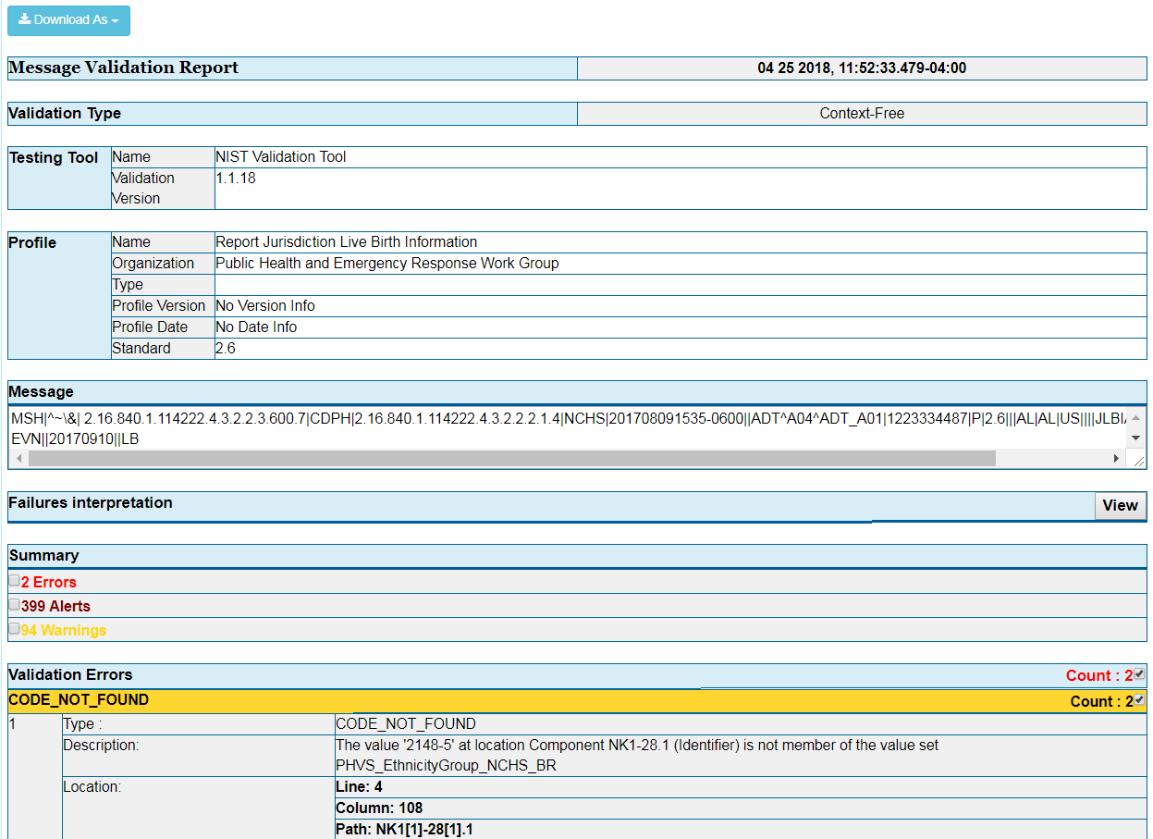
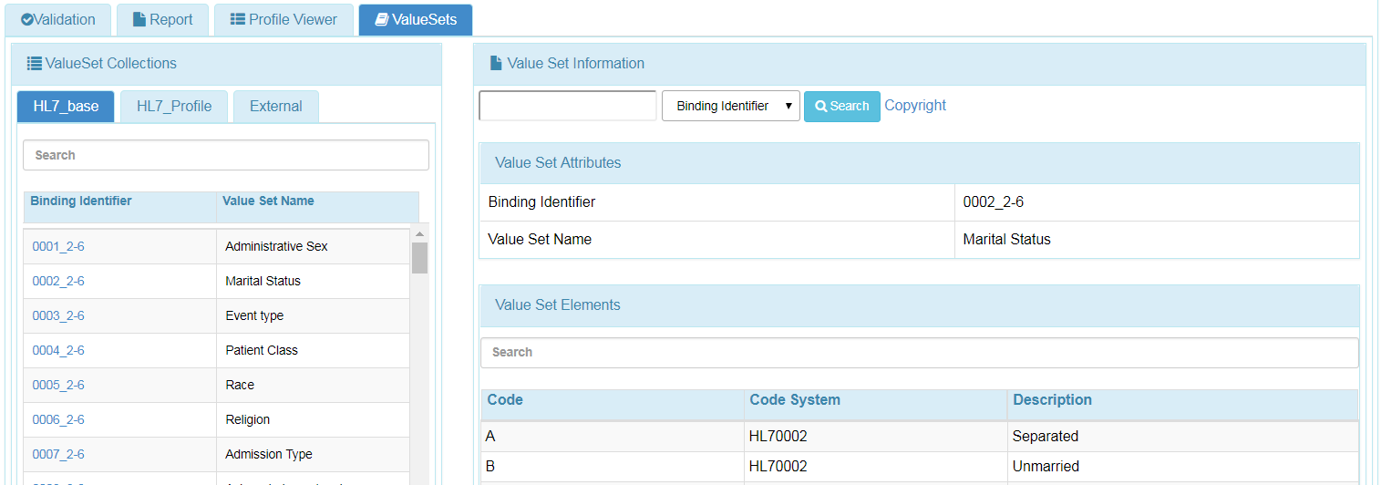
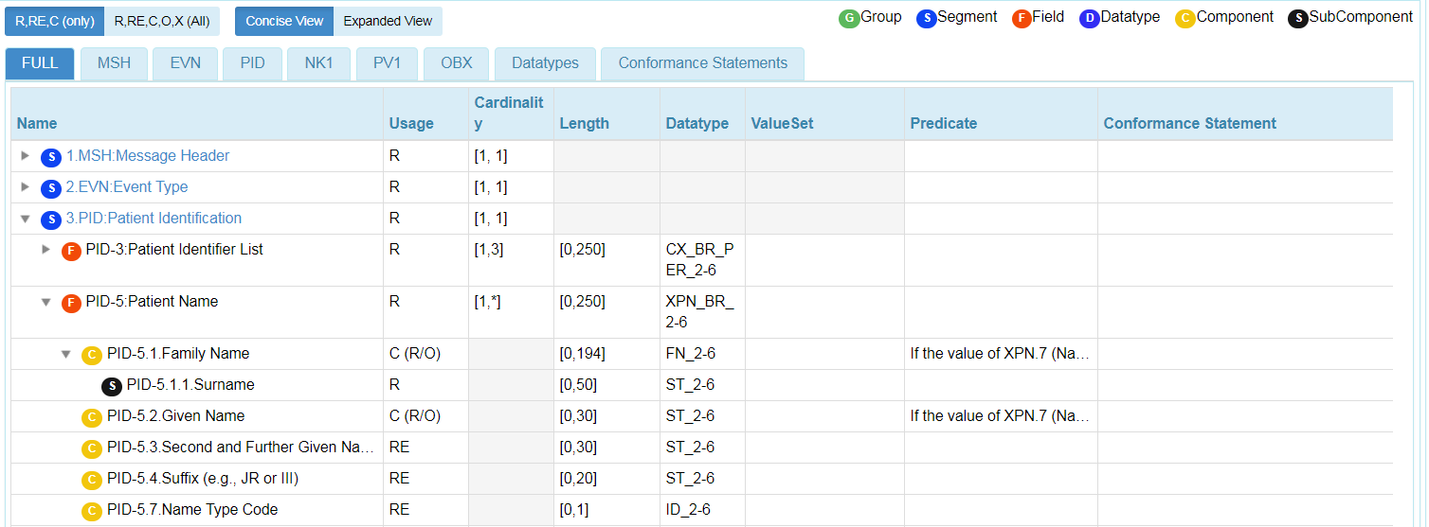
Context-free & Context-based – Utilities
View of Validation Report
View of Value Set Information
View of Profile Viewer

